Slide 1
Chest Tube Drainage: Glass Bottles
November 17, 2021

Slide 2
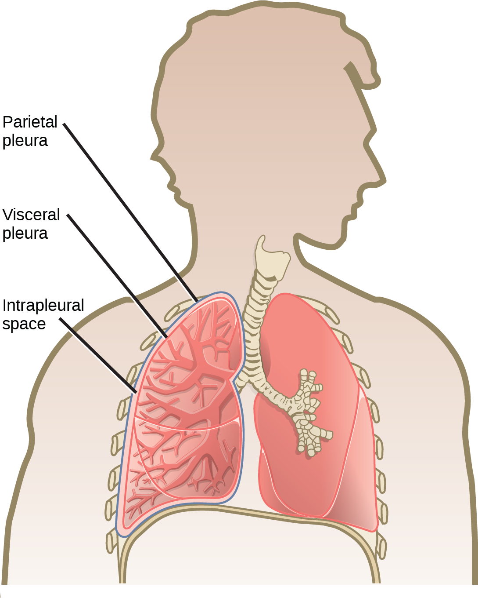
When Normal Respiration Goes Wrong
The lungs are surrounded by a pleural space composed of
Parietal pleura-lines the chest wall
Visceral pleura-lines the lungs
Lubrication-provided by 10-20 mL of pleural fluid
The negative pressure created by the diaphragm is what allows inspiration
Expiration is accomplished though natural recoil of the chest wall passively
When air or excess fluid is introduced into the pleural space, the lungs’ re-inflation (inspiration) is disrupted, negative pressure is lost and the mediastinal structures can shift to the opposite side of the thorax
Source: Merkle A & Candass R. Care of a chest tube. StatPearls: Treasure Island (FL) Available at: https://www.ncbi.nlm.nih.gov/pubmed/32310548 Accessed 11.17.2021
Note: This document is for informational purposes only and is not intended to replace individual clinical decision-making, which is the sole and independent responsibility of the practitioner. HealthTrust expressly disclaims any liability for treatment decisions. Please direct any questions or comments to clinical.research@healthtrustpg.com, or to your supplier representative. ©2021 HealthTrust. All Rights Reserved.

Slide 3
Chest Tube Drainage Systems: The Basics
The primary purpose of a chest tube drainage system is to drain the pleural space of air, blood, pus or lymph thereby restoring normal respiration
There are three separate chambers to a chest tube system that each perform a specific function
Collect the fluid and/or air drained from the chest
Prevent air from entering the chest
Control the level of suction being used to facilitate re-expansion of the lungs
Source: Frazer C. Managing chest tubes. Academy of Medical-Surgical Nurses; 21(12); 2021 Available at https://search.ebscohost.com/login.aspx?direct=true&db=rzh&AN=104531252&site=eds-live Accessed 11.17.2021
Note: This document is for informational purposes only and is not intended to replace individual clinical decision-making, which is the sole and independent responsibility of the practitioner. HealthTrust expressly disclaims any liability for treatment decisions. Please direct any questions or comments to clinical.research@healthtrustpg.com, or to your supplier representative. ©2021 HealthTrust. All Rights Reserved.

Slide 4
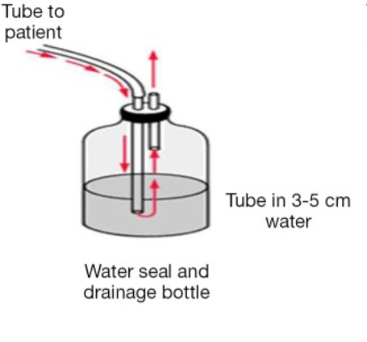
One Bottle Chest Drainage System
Collects and holds fluid from the chest and allows removal of air
Serves as water seal so air does not enter the chest
Straw submerged 2 cm below the surface of water (saline solution) which is connected to the chest tube
A second tube serves as a one-way valve (decompression vent) to remove excess air that is displaced by fluid or air from the chest
This system is preferentially used only for removing air because as drainage is removed from the patient, the level of the water seal is increased, thus decreasing the ability of the lung to overcome the pressure of the excess fluid
Source: Zisis C, Tsirgogiani K, Lazaridis G et.al. Chest drainage systems in use. Annals of Translational Medicine. 3(3):2015 Available at: https://www.ncbi.nlm.nih.gov/pmc/articles/PMC4356865/ Accessed 11.16.2021
Note: This document is for informational purposes only and is not intended to replace individual clinical decision-making, which is the sole and independent responsibility of the practitioner. HealthTrust expressly disclaims any liability for treatment decisions. Please direct any questions or comments to clinical.research@healthtrustpg.com, or to your supplier representative. ©2021 HealthTrust. All Rights Reserved.

Slide 5
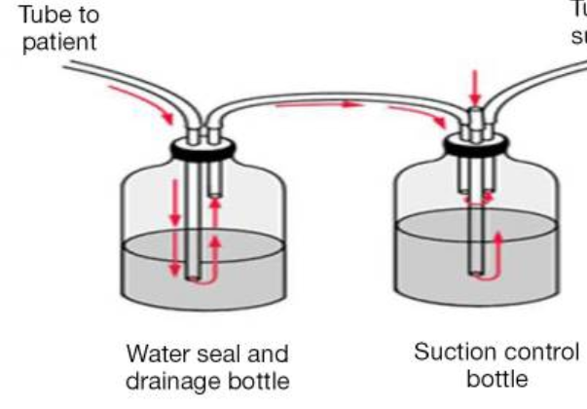
Two Bottle Chest Drainage System
The bottle to the patient allows for removal of air and fluid with a tube inserted well into the bottle
The second bottle serves as the water seal with a tube connecting to the first bottle and a water seal tube which is at 2 cm
A third tube is a one-way valve serving as the decompression vent
This can also be connected to a third bottle
These systems are gravity dependent and must be maintained below the level of the chest
Preferred for removal of larger amounts of fluid from the pleural space as it allows for fluid drainage without impacting the water seal
If this system is not sufficient, a third bottle can be added to offer suction control
Source: Zisis C, Tsirgogiani K, Lazaridis G et.al. Chest drainage systems in use. Annals of Translational Medicine. 3(3):2015 Available at: https://www.ncbi.nlm.nih.gov/pmc/articles/PMC4356865/ Accessed 11.16.2021
Note: This document is for informational purposes only and is not intended to replace individual clinical decision-making, which is the sole and independent responsibility of the practitioner. HealthTrust expressly disclaims any liability for treatment decisions. Please direct any questions or comments to clinical.research@healthtrustpg.com, or to your supplier representative. ©2021 HealthTrust. All Rights Reserved.

Slide 6
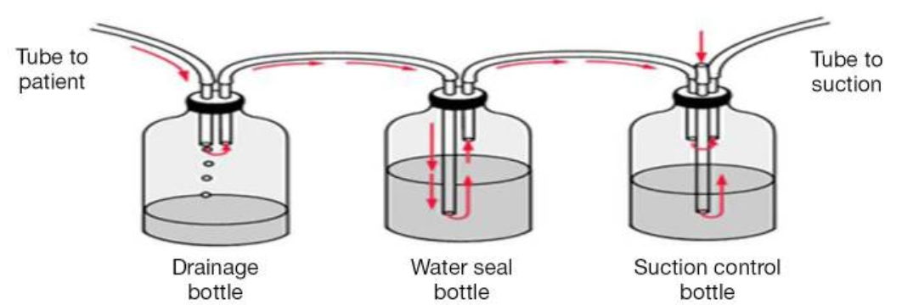
Three Bottle Chest Drainage System
Can be used if gravity drainage is not sufficient
The first bottle serves to collect air and drainage
The second is the water seal which continues at 2 cm
The third bottle is the suction control bottle which allows controlled application of suction
The suction control bottle has a ridged straw which is submerged to control the suction typically set at 20 cm of water
A third tube is connected to the suction on the wall
Source: Zisis C, Tsirgogiani K, Lazaridis G et.al. Chest drainage systems in use. Annals of Translational Medicine. 3(3):2015 Available at: https://www.ncbi.nlm.nih.gov/pmc/articles/PMC4356865/ Accessed 11.16.2021
Note: This document is for informational purposes only and is not intended to replace individual clinical decision-making, which is the sole and independent responsibility of the practitioner. HealthTrust expressly disclaims any liability for treatment decisions. Please direct any questions or comments to clinical.research@healthtrustpg.com, or to your supplier representative. ©2021 HealthTrust. All Rights Reserved.

Slide 7
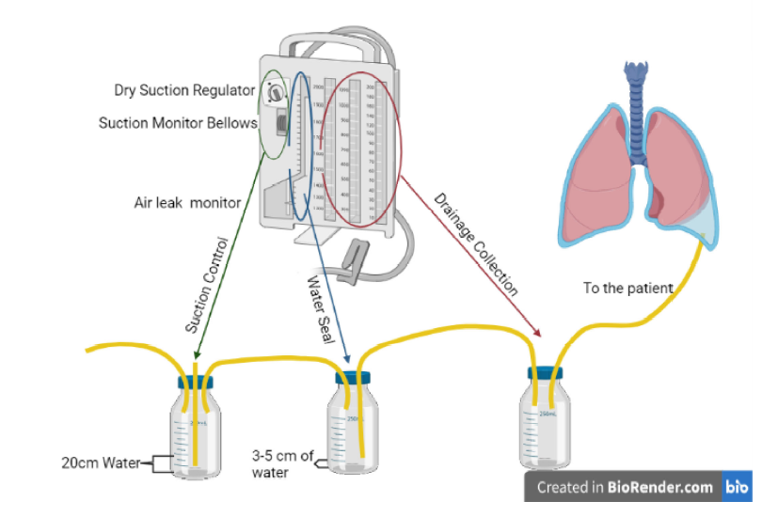
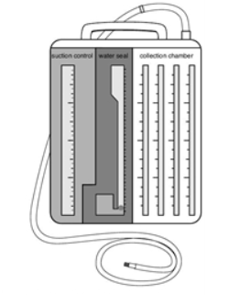
How Current Collection Systems Relate to Bottle Collection
Wet Suction Chest Drainage
Dry Suction Chest Drainage
Suction Control
Water Seal
Drainage Collection
Source: Frazer C. Managing chest tubes. Academy of Medical-Surgical Nurses; 21(12); 2021 Available at https://search.ebscohost.com/login.aspx?direct=true&db=rzh&AN=104531252&site=eds-live Accessed 11.17.2021
Dry Suction Chest Drainage Image: Adapted from “Chest tube drainage system”, by BioRender.com (2021). Retrieved from https://app.biorender.com/biorender-templates Created 11.17.2021.
Note: This document is for informational purposes only and is not intended to replace individual clinical decision-making, which is the sole and independent responsibility of the practitioner. HealthTrust expressly disclaims any liability for treatment decisions. Please direct any questions or comments to clinical.research@healthtrustpg.com, or to your supplier representative. ©2021 HealthTrust. All Rights Reserved.

Slide 8
Basic Care of Chest Tubes
The activity below should be done per individual hospital protocol
Assess the patient’s respiratory status (lung sounds, pulse oximetry, respiratory rate and respiratory effort)
Monitor chest tube insertion (dressing, drainage and subcutaneous emphysema)
Observe chest tubing(confirm tube connections and ensure tubing is free from obstructions and dependent loops)
Check the amount and character of drainage
Collection system check to ensure the following:
The system is secured in upright position
Presence or absence of air leak
Presence or absence of tidaling
Water level at appropriate level for water seal (typically submerged 2cm)
Suction level as ordered by physician (typically 20cm)
Apply continuous suction as ordered by the physician
Source: Frazer C. Managing chest tubes. Academy of Medical-Surgical Nurses; 21(12); 2021 Available at https://search.ebscohost.com/login.aspx?direct=true&db=rzh&AN=104531252&site=eds-live Accessed 11.17.2021
Note: This document is for informational purposes only and is not intended to replace individual clinical decision-making, which is the sole and independent responsibility of the practitioner. HealthTrust expressly disclaims any liability for treatment decisions. Please direct any questions or comments to clinical.research@healthtrustpg.com, or to your supplier representative. ©2021 HealthTrust. All Rights Reserved.

